Slide 1
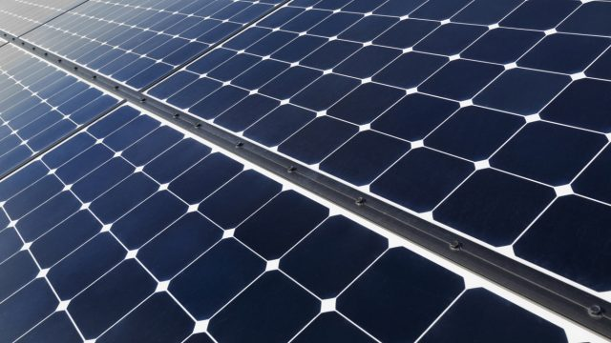
BONANZA PEAK SOLAR PROJECT
COMMUNITY UPDATE
November 4, 2025
Bonanza Peak Solar Project

Slide 2

About 174 Power Global, Bonanza Peak Solar, LLC
Over 2 GW of projects in construction or operation
14 years of experience in North American utility-scale photovoltaic (PV) project development
Currently developing over 10,000 MW of solar PV projects, including some of the largest projects in North America
Headquartered in Irvine, California and Houston, Texas
Bonanza Peak Solar Project

Slide 3
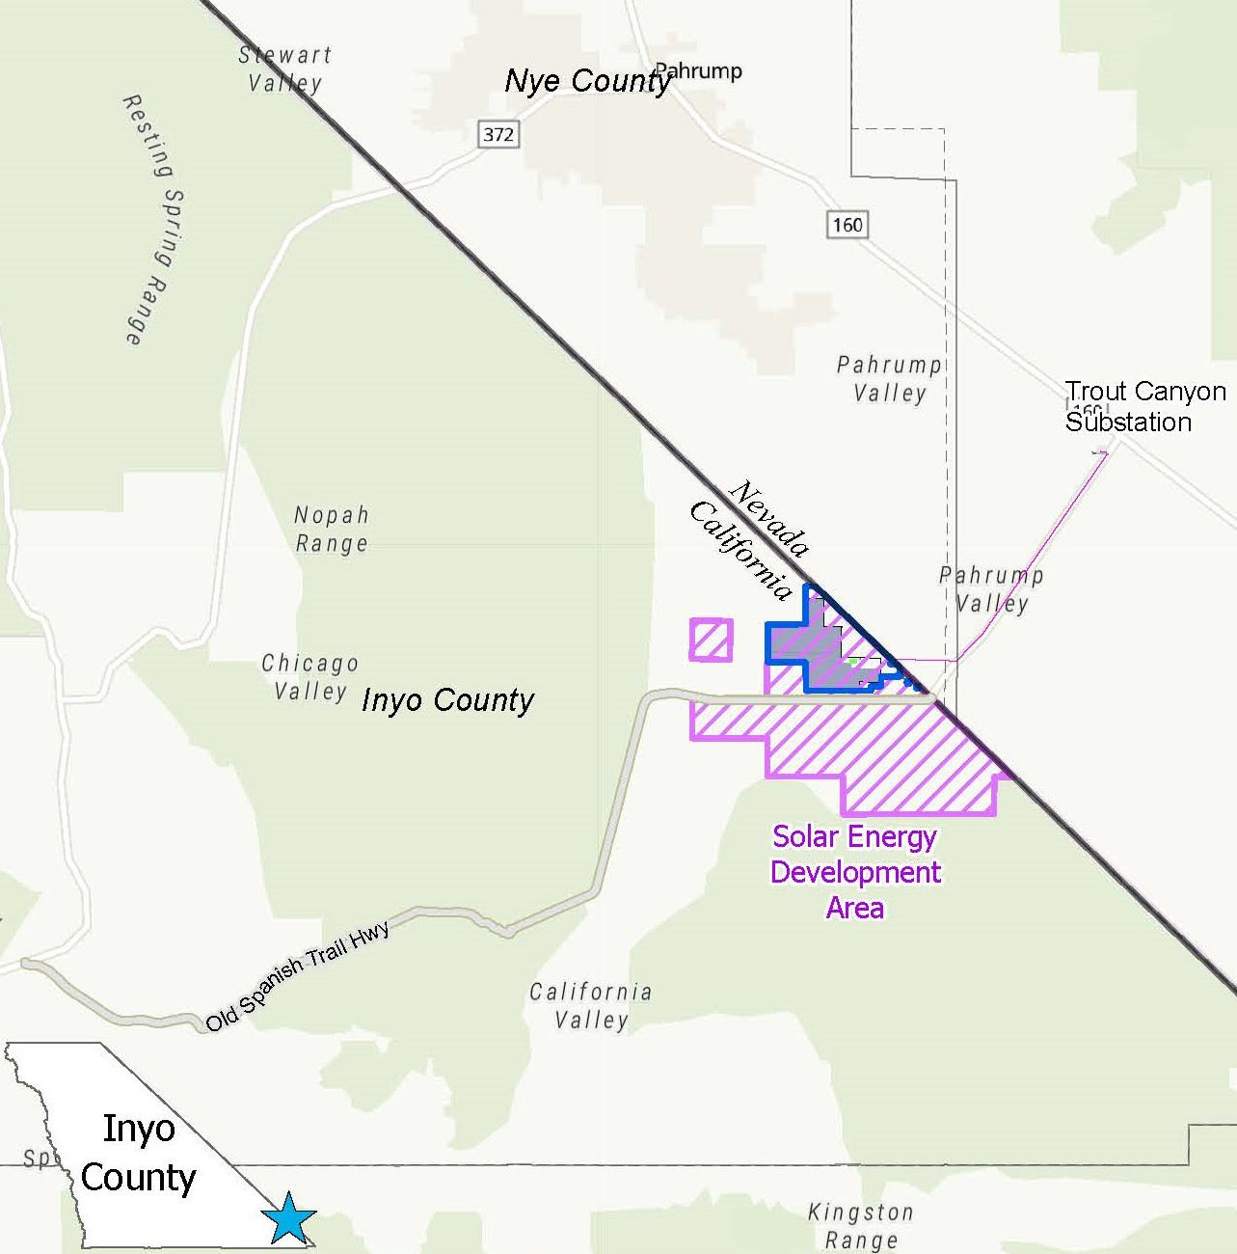
Project Overview
Overview: Up to 500 MW solar PV power on up to 2,400 acres of privately-owned land in Inyo County’s Charleston View Solar Energy Development Area (SEDA)
Point of Grid Interconnection: Trout Canyon switchyard in Nevada via a new 9-mile transmission line on BLM land
Access: Construction access from Nevada Route 160 to Tecopa Road/Old Spanish Trail Highway. Traffic will then turn north onto Zircon Street which will be improved to support construction traffic. This route will also be used once the Project is operational.
Timeline: County permit application submitted in July 2024. Followed by ~ 12 - 18 month CEQA analysis. Targeting Q1 of 2027 construction start and complete in approximately 18 months, in one or more phases

Slide 4
Project Update
Through outreach and County coordination, we learned that the battery energy storage system (BESS) originally proposed as part of the Project had led to concerns about potential fire safety related to a BESS
To strengthen community and County confidence in the Project, the BESS was removed and is no longer proposed
Bonanza Peak Solar Project

Slide 5
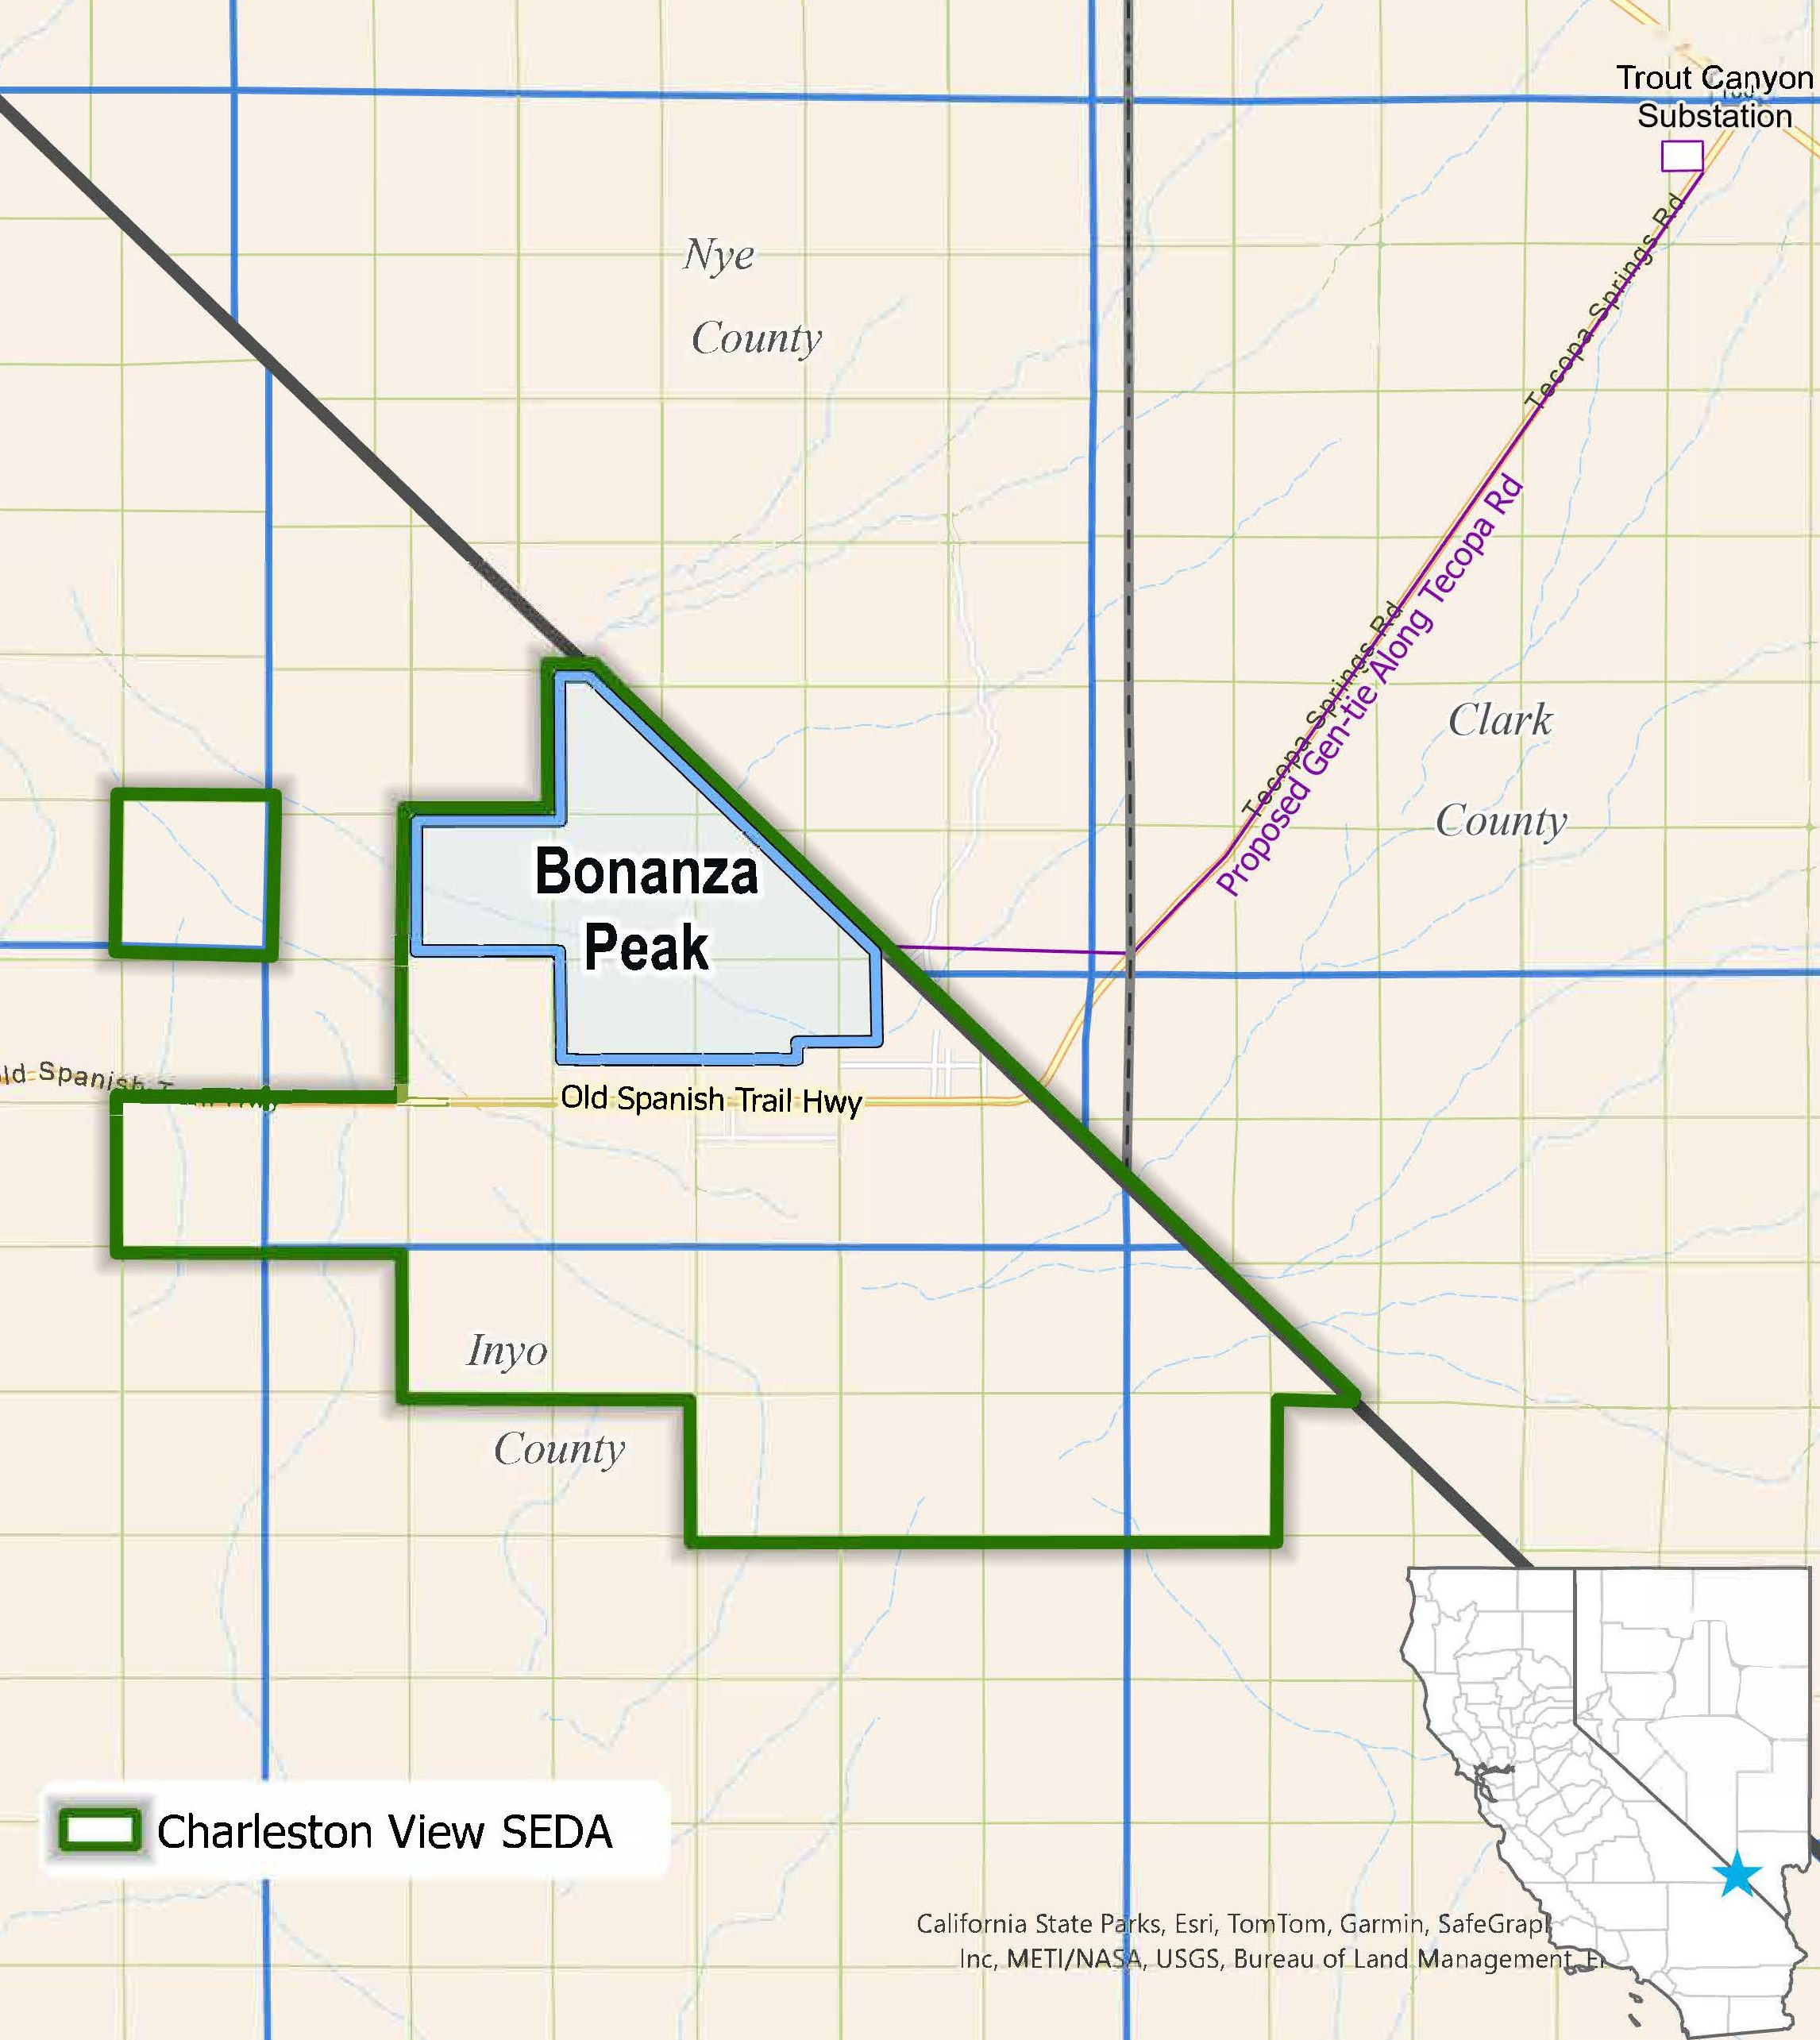
Charleston View SEDA
The Charleston View SEDA is an unincorporated area zoned for PV solar and specifically chosen by the County for this purpose
Project will adhere to the SEDA’s requirements to:
  Develop no more than 2,400 acres of development and 500 MW of solar capacity
  Be water sustainable and replace water used from the aquifer (1:1 ratio) by purchasing and retiring equivalent water rights
  Consider visual impacts from Old Spanish Trail Highway (closest arrays are ~1,300 feet away)
  Avoid and protect the Old Spanish Trail historic feature
Bonanza Peak Solar Project

Slide 6
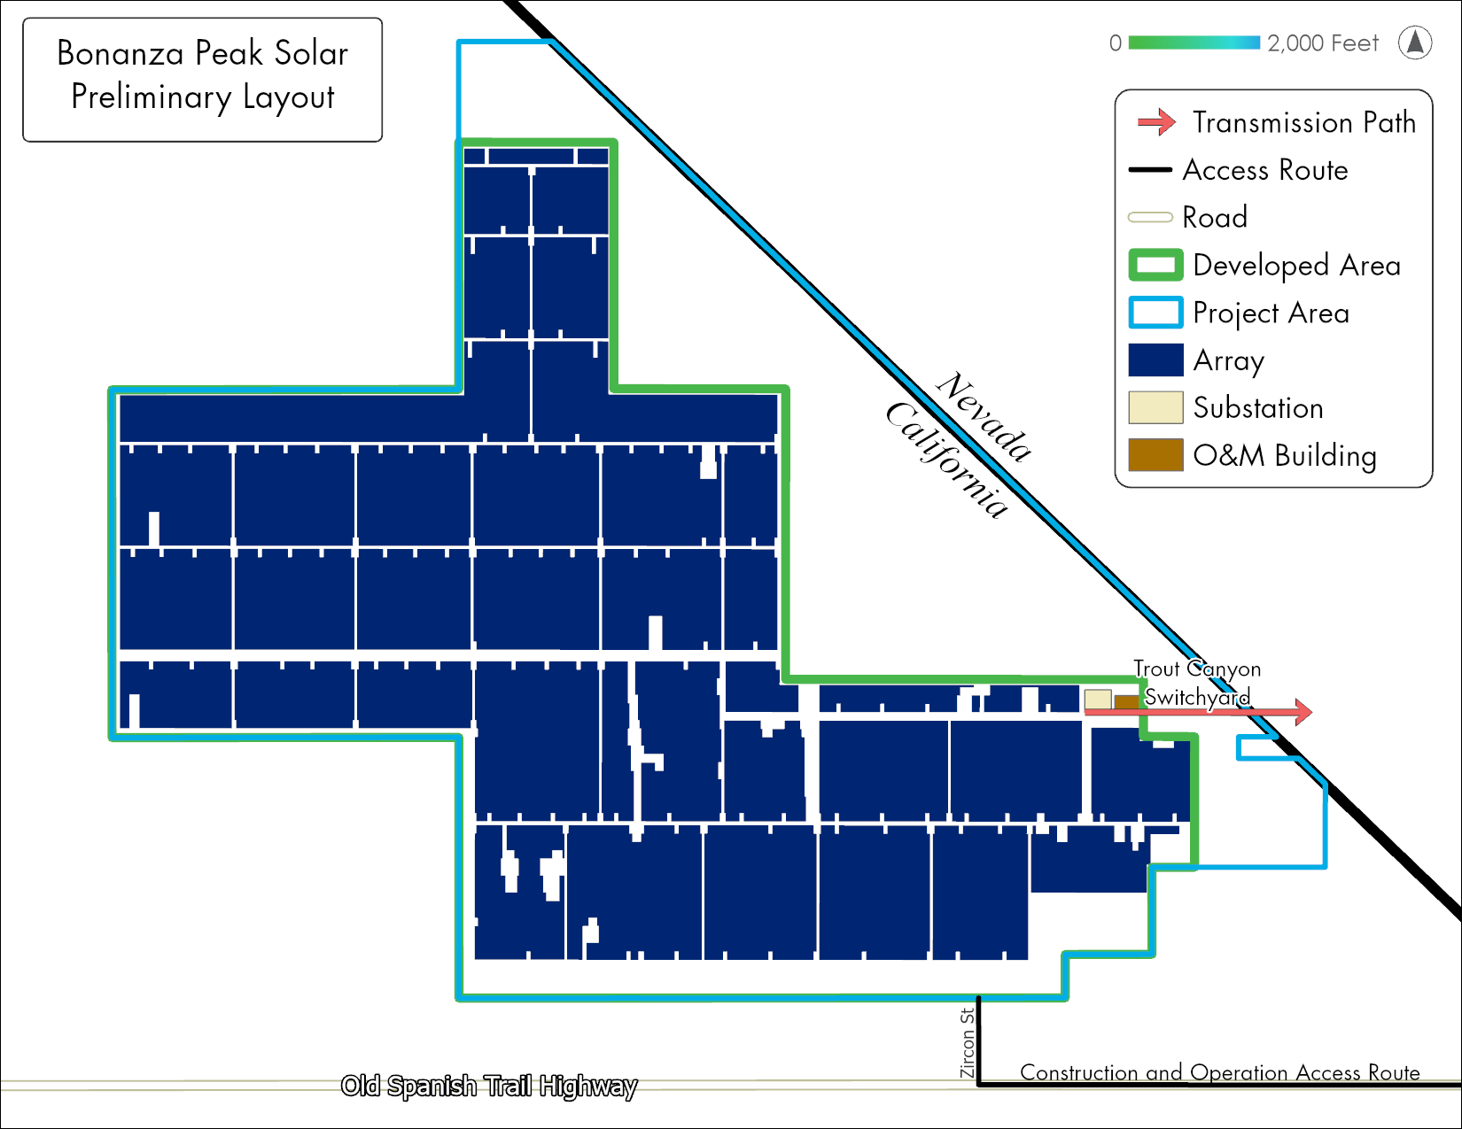
PV solar modules on single-axis trackers
Overhead and underground electric collection lines
Inverters and transformers
Substation
O&M building
Power plant controls and monitoring
Fencing and access roads

Slide 7
Agency Analysis
The County-led CA Environmental Quality Act process will include Project-specific environmental, social, and economic impact analysis
The BLM-led National Environmental Policy Act will address impacts related to the transmission line from the project to the Trout Canyon substation in Nevada
Consultation is occurring with CA Fish & Wildlife and US Fish & Wildlife to obtain applicable authorizations and identify environmental protection measures and mitigation related to special status wildlife
Project will obtain a water discharge permit from the local water quality board
Bonanza Peak Solar Project

Slide 8
Project Considerations
Grading of the terrain will be limited, and likely to occur at the substation area and O&M building parking
Water for construction and operations will come from existing wells provided by the Project landowner
Construction dust will be minimized by having gravel on all Project roads and applying water as needed during construction
Solar panel washing is not contemplated; this will minimize water use during operations
Workers are expected to generally come from housing in Nevada, due to availability and proximity to the Project Area
Ongoing Charleston View landowner and local stakeholder engagement
Bonanza Peak Solar Project

Slide 9
Community Benefits
The Project will include support for a new Southern Inyo Fire District facility in Charleston View
This support will consist of land for the facility, plus financial support for the construction and equipment
Discussion with the County is ongoing, and other benefits may be identified
Community benefits will be included as either a condition of the Renewable Energy Permit, or in a Renewable Energy Development Agreement
Bonanza Peak Solar Project

Slide 10
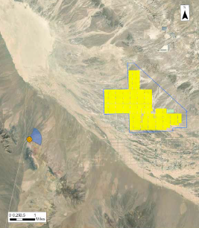
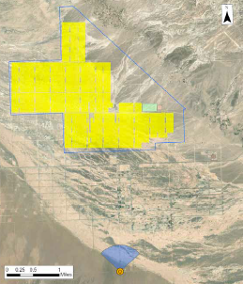
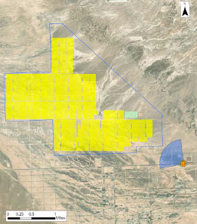
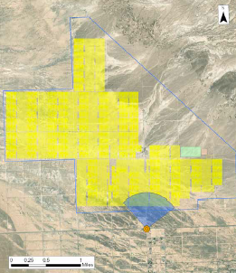
Visual Resources
Glare modeling indicates no glare will be generated at any of 12 key observation points
Visual simulations were prepared for four locations around the Project:
Bonanza Peak Solar Project

Slide 11
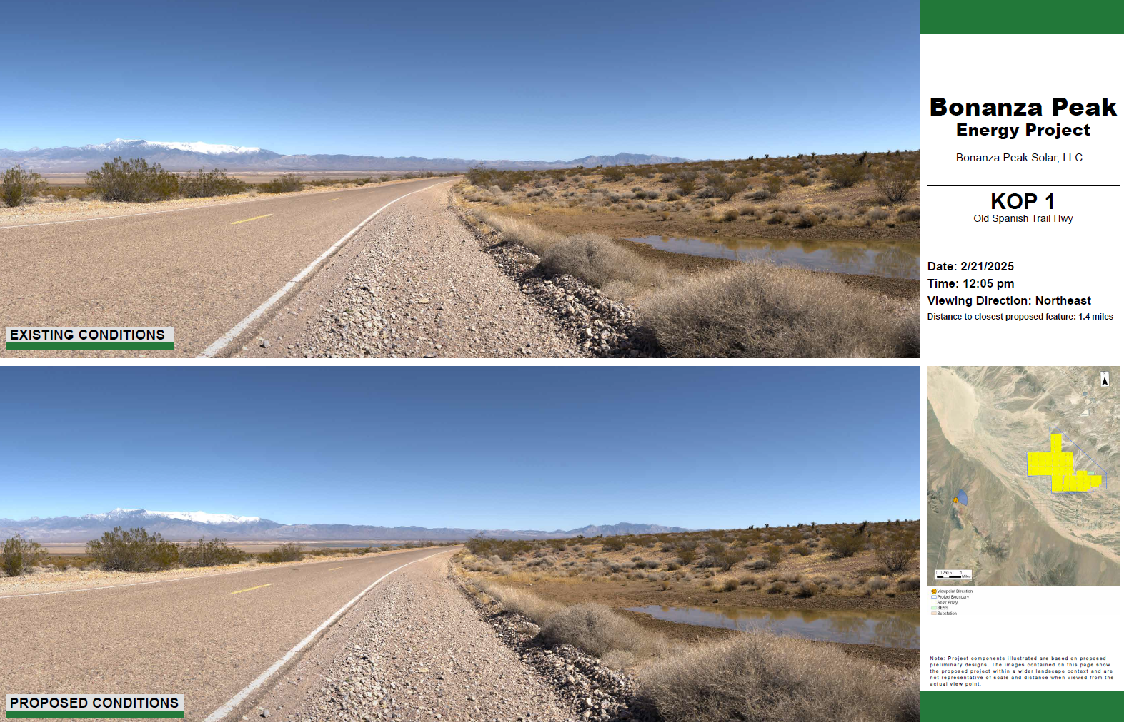

Slide 12
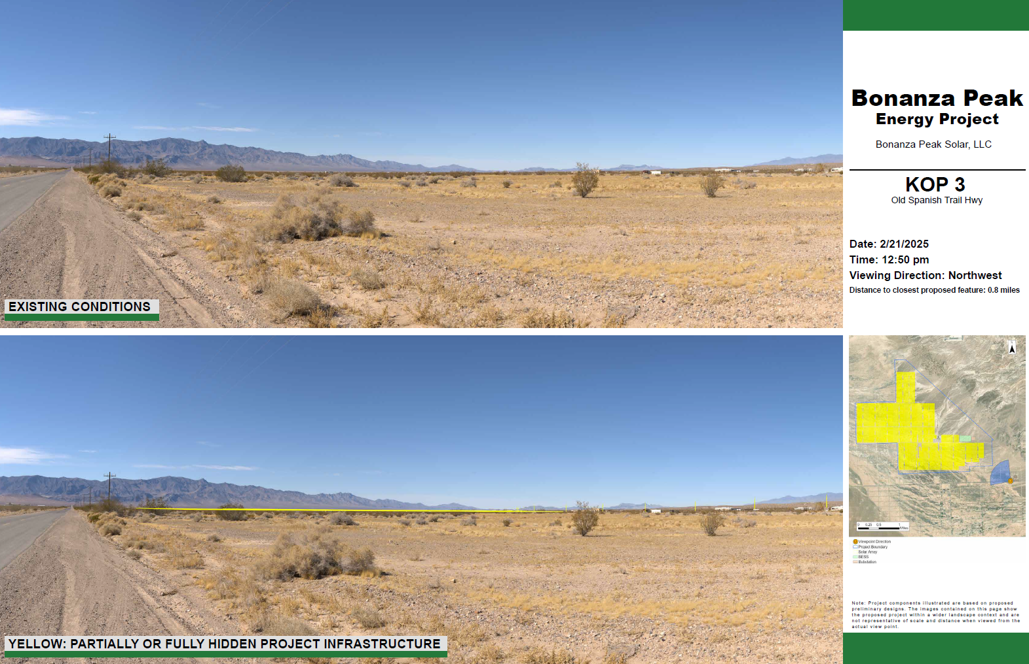

Slide 13
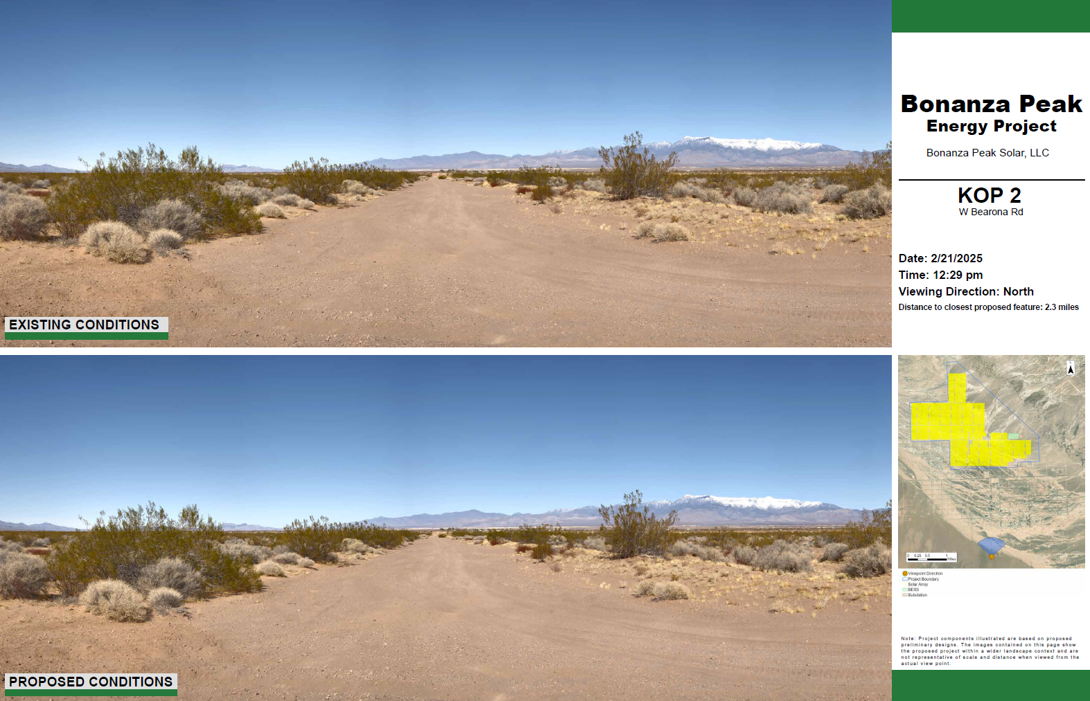

Slide 14
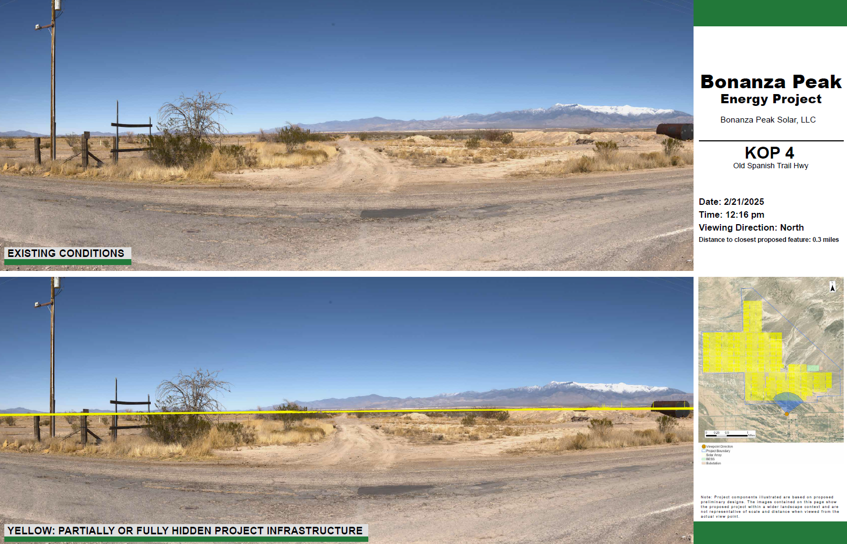

Slide 15
Environmental Resources
Desert tortoise surveys conducted in 2020, 2024, and 2025; the site has lower quality habitat for tortoise than other areas in the vicinity
Plant surveys were conducted in spring and fall 2025; none of the plants detected are federally- or state-listed as threatened or endangered. Applicant is coordinating with CA Fish & Wildlife and Inyo County to incorporate results into the CEQA document
A Class III Cultural Resources Inventory was conducted in 2025 and will help inform design; the Old Spanish Trail historic feature is not located within or adjacent to the site
Previous hydrologic study indicated there is adequate groundwater for the Project’s construction and operational needs, and drawdown to the aquifer would not occur at either nearby private domestic wells or Stump Spring
Bonanza Peak Solar Project

Slide 16
Thank you!
Bonanza Peak Solar Project

